Slide 1
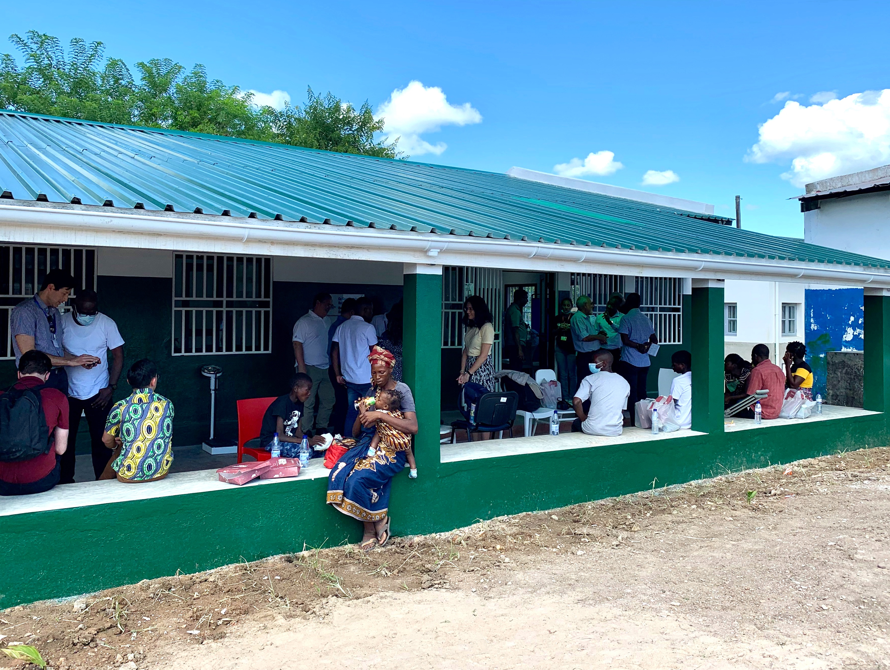


M&E Technical Session
December 2024
Notes:
Dev

Slide 2
Welcome
Who is in the room? (In the chat)
Name/Country/Clinic
City/ Town you are calling from
Notes:
Dev

Slide 3
Agenda
Welcome (5 Minutes)
What is new in quarter 4 (20 Minutes)
Tally sheet changes (10 Minutes)
Q3 data review (5 minutes)
Questions & feedback (15 minutes)
Reporting reminders (5 Minutes)
Notes:
Dev
These slides will be made available after the meeting
Quarter 4

Slide 4
Data Collection Calendar
December 2024
November 2024
March 2025
April 2025
January 2025
February 2025
January 2025
M&E technical session
You will receive Q4 report template
Q4 report opens
M&E office hours
Q4 report review
Q4 report back (Monthly Meeting)
M&E technical session
You will receive Q1-2025 report template
Q1 report opens
M&E office hours
Notes:
Dev
talk about Quarter 4 roll out

Slide 5
What is New in Q4
Training indicators
Stockout indicators
Clinical indicators
Narrative section
Notes:
Collin

Slide 6
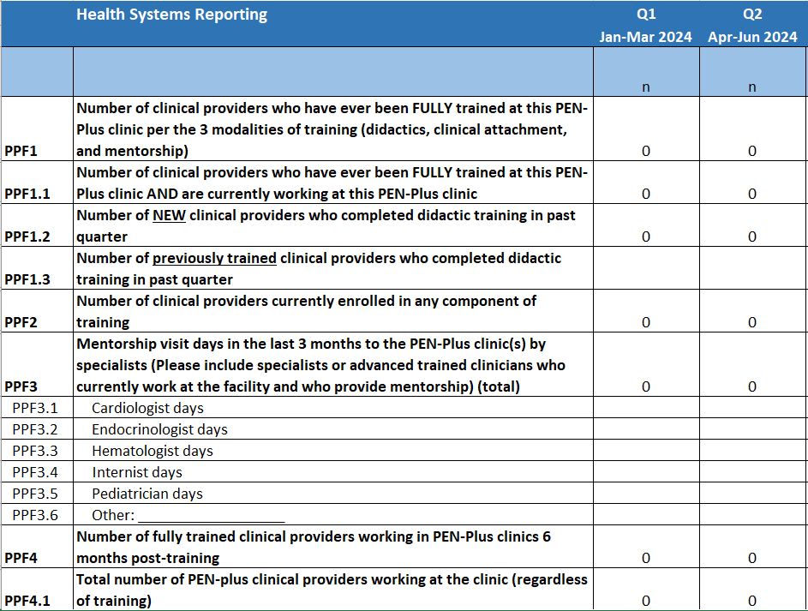
What is New in Q4 – Training Indicators
Notes:
Collin
New or modified indicators shown by blue arrows. Provider subcategories are hidden
Definitions:
PPF1. Number of providers who have ever been FULLY trained at this PEN-Plus clinic per the 3 modalities of training (didactics, clinical attachment, and mentorship)
Number of providers who have ever completed (1) all didactic training, (2) practical clinical attachment, and (3) mentorship logbook in PEN-Plus at this clinic ever
PPF1.1
Number of providers who have ever been FULLY trained at this PEN-Plus clinic AND are currently working at this PEN-Plus clinic
Number of providers who are currently working at the clinic AND have completed (1) all didactic training, (2) practical clinical attachment, and (3) mentorship logbook in PEN-Plus at this clinic
PPF1.2
Number of providers who completed didactic training in past quarter
Number of providers who completed didactic training in past quarter including attending, completing, and passing all components of PEN-Plus didactics course in the last 3 months
PPF1.3
Number of providers who completed mentorship logbook in past quarter
Number of providers who reached completion of mentorship in the last quarter, meaning each competency in the logbook has been seen at least 3 times by the learner
PPF2
Number of providers currently enrolled in any component of training
Number of providers currently enrolled in any component of training (didactics or e-learning; clinical attachment; mentorship)
PPF3
Number of mentorship visit days conducted in the last 3months
Number of days of mentorship visits conducted in the last 3 months
PPF4
Number of providers who are currently working at the clinic AND are fully trained
Number of providers who are currently working at the clinic AND have completed (1) all didactic training, (2) practical clinical attachment, and (3) mentorship logbook in PEN-Plus at this clinic
PPF4.1
Total number of PEN-plus providers working at the clinic
the number of providers currently working at the clinic

Slide 7
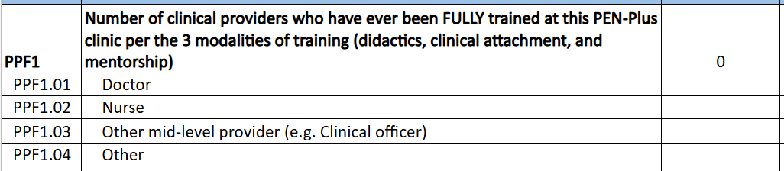
What is New in Q4 – Training Indicators
For indicators PPF1, PPF1.1, PPF1.2, PPF1.3, PPF4 and PPF4.1, please disaggregate numbers by the following categories:
Notes:
Collin
All training indicators except PP3 (mentorship) ask for this dissaggregation

Slide 8
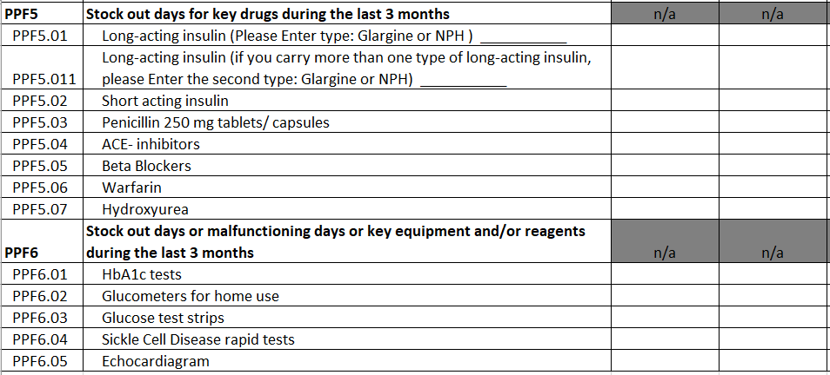
What is New in Q4 – Stockout indicators
Notes:
Collin
Total number of stock out days for key drugs. This list the same for each clinic
Total number of stock out days for key equipment and/or reagents during the last 3 months
Each subindicator under PPF5 and PPF6 should not exceed 90 days.
If you don't have SCD in your catchment area, please write n/a for SCD related- SCD tests, hydroxyurea and penicillin?

Slide 9
What is New in Q4 – Clinical reporting
Changing age surveillance from <18 to <30
Notes:
Collin
PP2 is changed to Active patients under 30 years

Slide 10
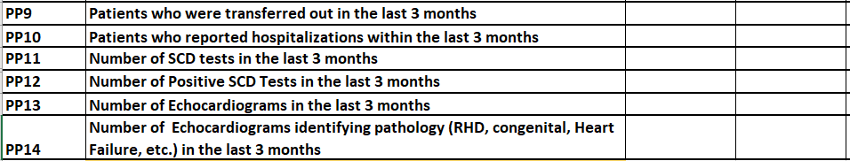
What is New in Q4 – Clinical reporting
New indicators P11-PP14: Number of tests for SCD and Echocardiograms
Notes:
Collin
Re-iterate: PP9 and PP10 are "in the last 3 months"
PP11- #SCD tests conducted at that clinic in the last 3 months
PP12- #SCD tests that were positive
PP12<PP11
PP13- #Echocardiograms conducted at the clinic in the last 3 months
PP14- # Echocardiograms that identified a pathology in the last 3 months
PP14<PP13

Slide 11
What is New in Q4 – Clinical reporting
  We no longer require reporting for-
  PP4 Patients who had a visit within the last 3 months
Notes:
Collin

Slide 12
Reminder – Clinical reporting Q4 (Active)
Has not died
Not Lost to follow up
Active
Enrolled in care
Active
Patients who had a visit in the last 3 months
Notes:
Collin
Re-iterate: PP6 is for patients newly lost to follow up in the last 3 months

Slide 13
Reminder – Clinical reporting Q4
Has not died
Not Lost to follow up
Active
Enrolled in care
Patients who had did NOT have a visit in the last 3 months
Patients who had a visit in the last 3 months
Notes:
Re-iterate: PP6 is for patients newly lost to follow up in the last 3 months

Slide 14
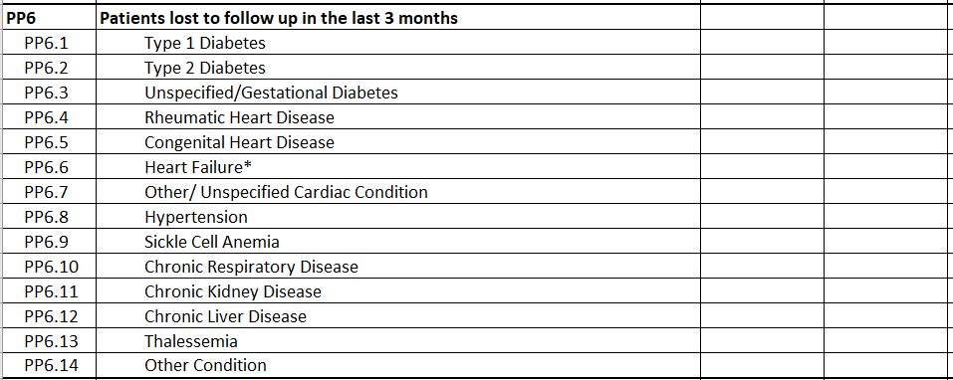
Reminder – Clinical reporting Q4 (Lost to follow-up)
Notes:
Collin
Re-iterate: PP6 is for patients newly lost to follow up in the last 3 months
Suggestions on how to reduce the burden of LTFU – section off LTFU, Death, and transferred out

Slide 15
What is New in Q4 – Review
Health Systems Reporting
Disaggregation by type of provider- Doctor, Nurse, Other mid-level provider (CO), Other
Number of new clinical providers who completed didactic training in the past quarter
Number of previously trained clinical providers who completed didactic training in the past quarter
Total number of PEN-plus clinical providers working at the clinic (regardless of training)
Stock out days for key drugs during the last 3 months- Long acting insulin, short-acting insulin, penicillin, ACE-inhibitors, b-blockers, warfarin, hydroxyurea
Stock out days or malfunctioning days or key equipment and/or reagents during the last 3 months- HbA1C tests. Glucometer, Glucose test strips, SCD rapid tests, Echocardiogram
Notes:
Collin

Slide 16
What is New in Q4 – Review
Clinical Data Reporting
PP2: Active patients <30 years
PP4: Patients who had a visit within the last 3 months is no longer needed
PP6: Patients lost to follow up in the LAST 3 MONTHS
PP11: Number of SCD tests, PP12: Number of positive SCD tests
PP13: Number of Echocardiograms, PP14: Number of Echocardiograms identifying pathology (RHD, congenital, Heart Failure, etc.) in the last 3 months
Notes:
Collin

Slide 17
What is New in Q4 – Narrative Question Ideas
Paper Based Data collection
Digital database tools (Excel, Kobo toolbox)
Digital Health Information systems (e.g. patient-level DHIS2)
Electronic Medical Record systems / Electronic Health Records systems (e.g. OpenMRS)
“Digital Health Information Systems”
Notes:
Collin

Slide 18
What is New in Q4 – Narrative Question Ideas
Do you collect patient-level data using a digital health information system to track NCD care (Not including Excel, Kobo toolbox and other databases): ☐ YES ☐ No
  If yes, what is the name of the software(s) used?
  OpenMRS
  OpenSRP / ONA
  DHIS2 (patient level data)
  Bahmni
  CommCare
  SmartCarre
  BAOBA
  SPICE / Medtronic Labs
  Other Please specify ___________
Note: If multiple software’s are used, please mention all and specify how they are used
If no
what do you need to be able to implement a digital health information system?
Where are you in the process of digitization?
Are there digital health information systems you are considering?
Notes:
Collin

Slide 19
What is New in Q4 – Narrative Question Ideas
What challenges are you facing or have you faced related to implementing a digital health information system?
What steps are you taking (if any) to overcome these challenges?
Is there and Electronic Medical Record system you eventually want to implement? If yes, which one and what would you need in order to implement it?
Notes:
Collin

Slide 20
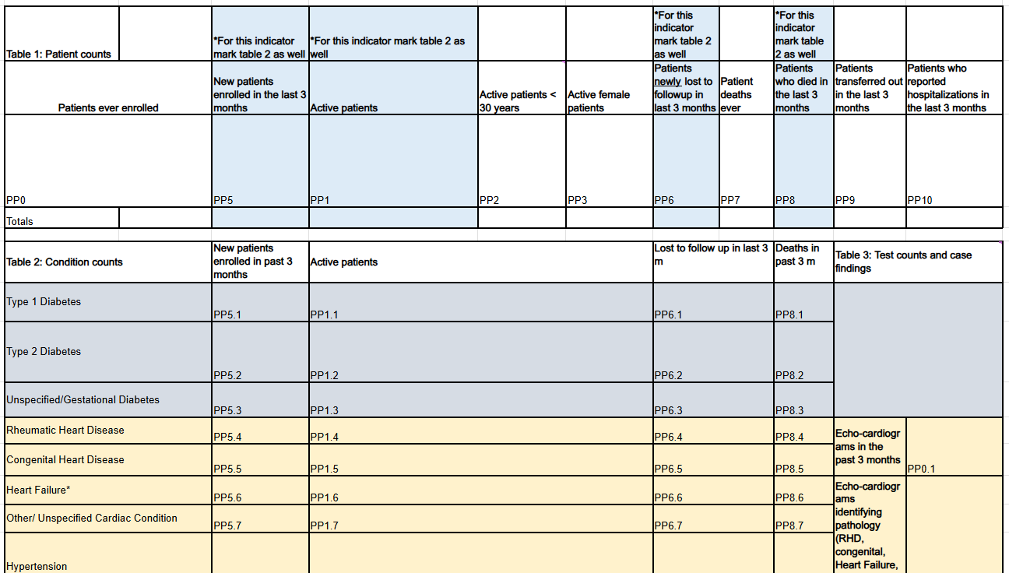
What is New in Q4 – Tally sheet changes
Notes:
Dev

Slide 21
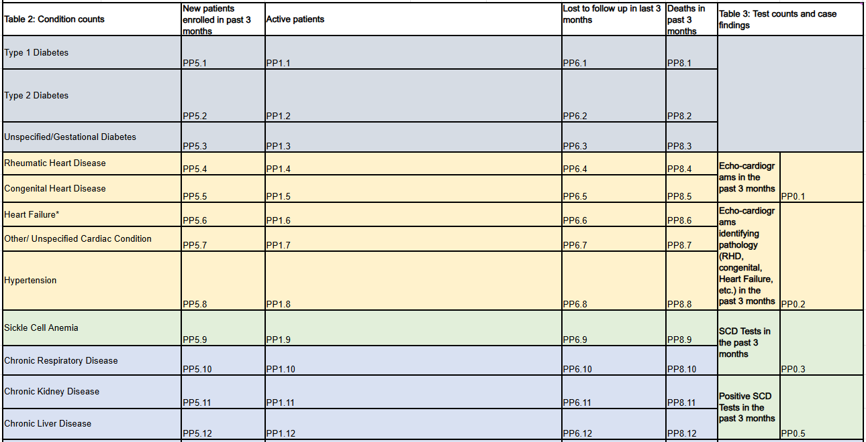
What is New in Q4 – Tally sheet changes
Notes:
Dev

Slide 22

Questions and Feedback
Notes:
Dev
15 minutes.

Slide 23
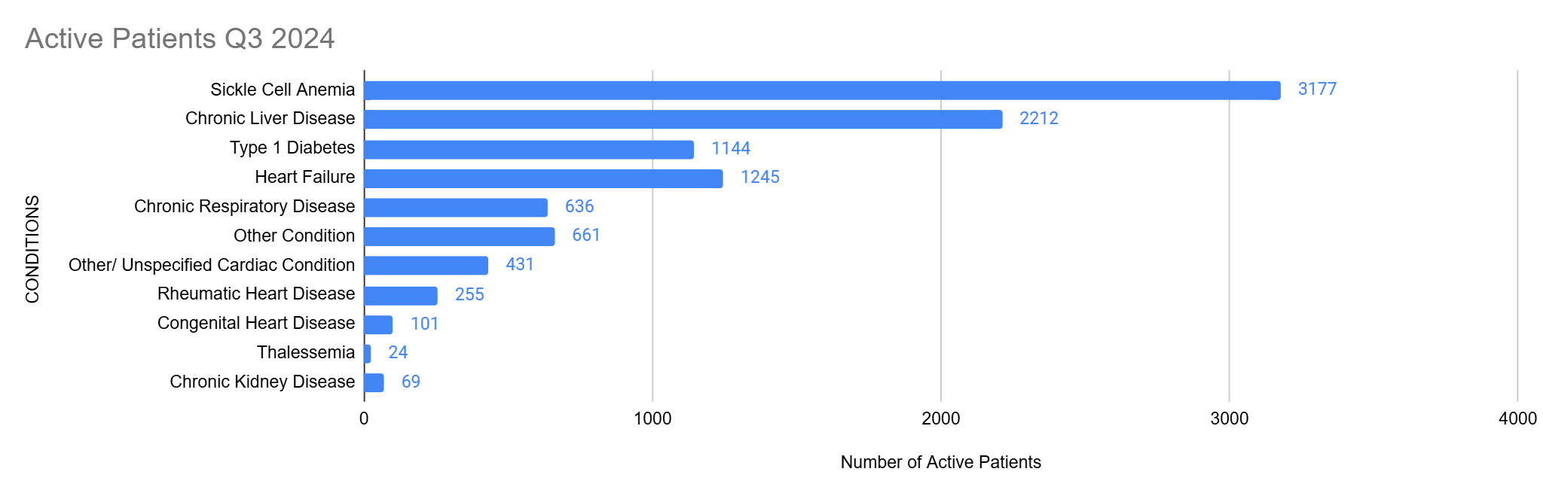
Q3 Review
Total active across PEN-Plus expansion clinics: 15218
Notes:
Dev

Slide 24
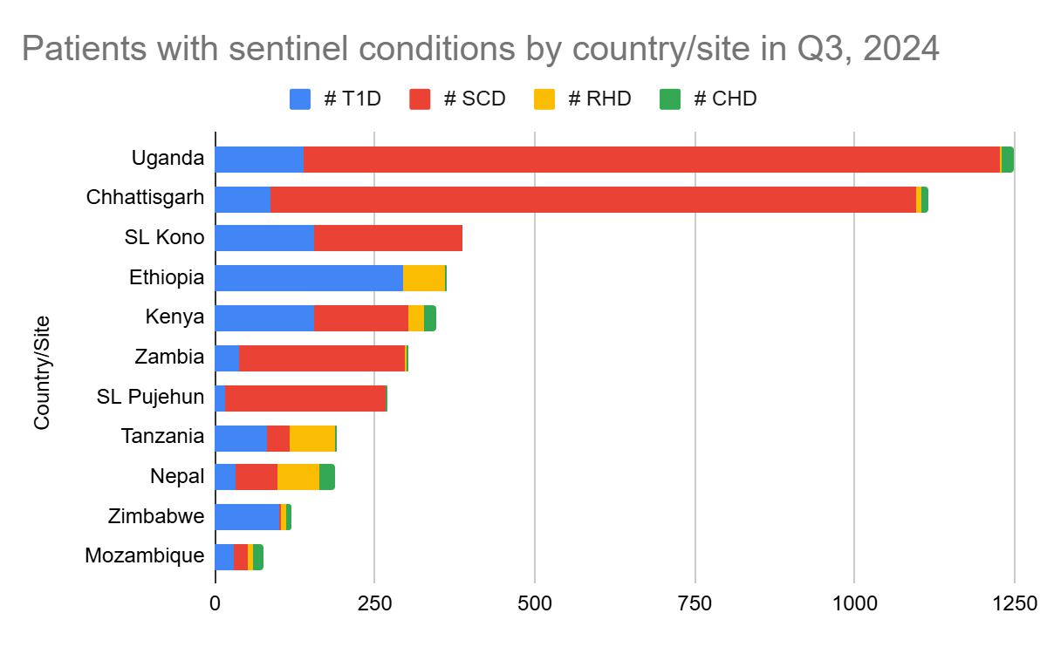
Q3 Review
Totals for sentinel conditions across PEN-Plus expansion-
T1D:1144
SCD: 3177
RHD: 255
CHD:101
Notes:
Dev

Slide 25
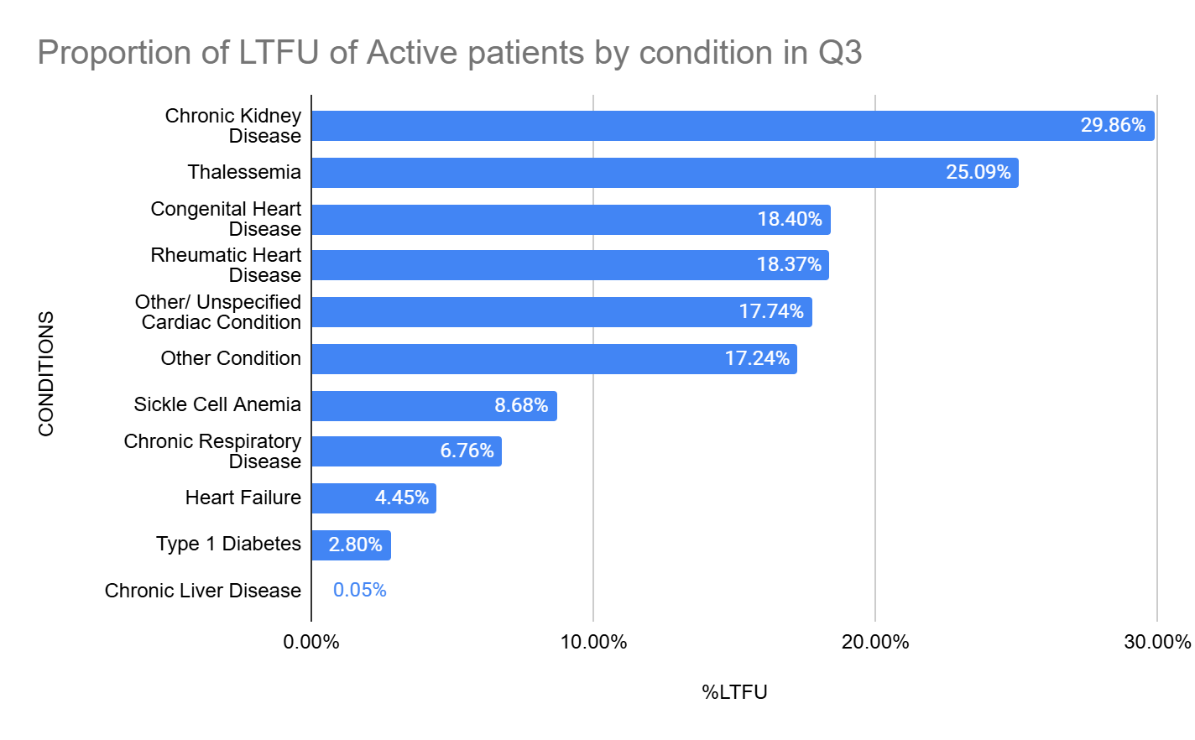
Q3 Review
Average %LTFU for all conditions is 13.59%
Notes:
Dev

